Slide 1
Codeforces Guide
2022/6/8
Hongfei Yan

Slide 2
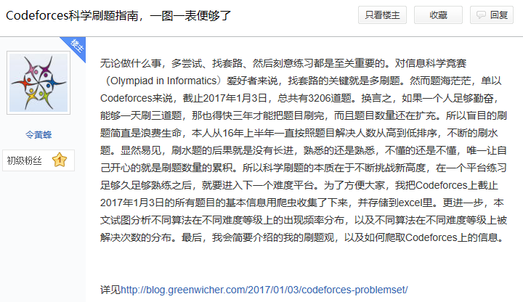
Codeforces吧， http://tieba.baidu.com/f?kw=codeforces&fr=home

Slide 3
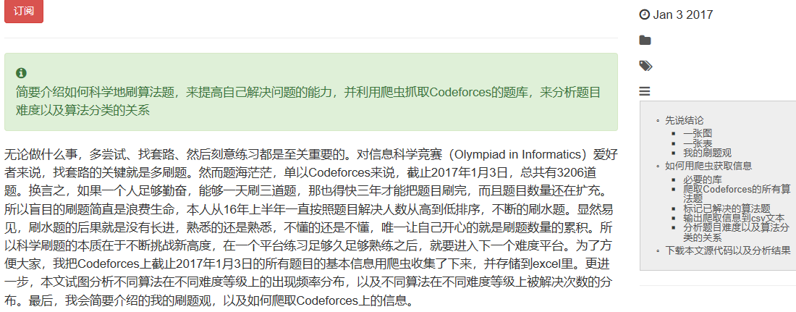
Codeforces科学刷题指南，一图一表便够了 http://blog.greenwicher.com/2017/01/03/codeforces-problemset/
Notes:
http://blog.greenwicher.com/2017/01/03/codeforces-problemset/

Slide 4
大纲
先说结论
一张图、一张表、刷题观
如何用爬虫获取信息
必要的库
爬取Codeforces的所有算法题
标记已解决的算法题
输出爬取信息到csv文本
分析题目难度以及算法分类的关系
下载源代码以及分析结果

Slide 5
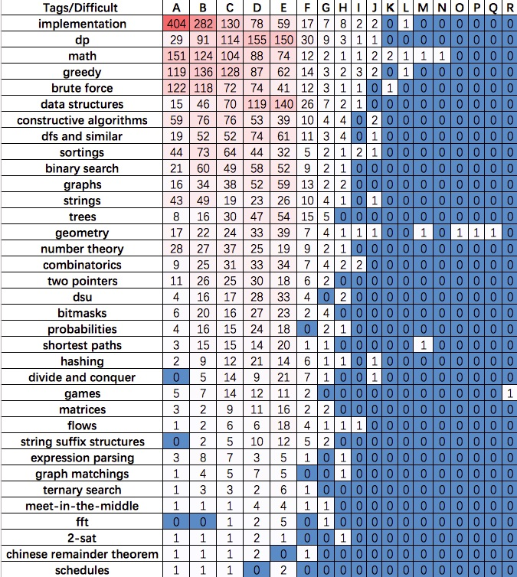
不同算法（第一列）
在不同问题难度（第一行）上的频率分布
大概就可以知道在什么样的水平下应该掌握什么样的算法。按照题号（A、B、C等等）来推断难度。
对简单的A题而言，大部分都是考察基本的编程功底，
诸如implementation（大概就是题目说什么，你做什么就是了），
math（四则运算、取模取整等等）
以及brute force（暴力枚举）
随着难度的增加，比如说E题，主要就在于
考察dp（动态规划），
data structures（数据结构）
高难度题目主要在
math，
geometry（计算几何），
shortest path（图论）
以及games（博弈）上

Slide 6
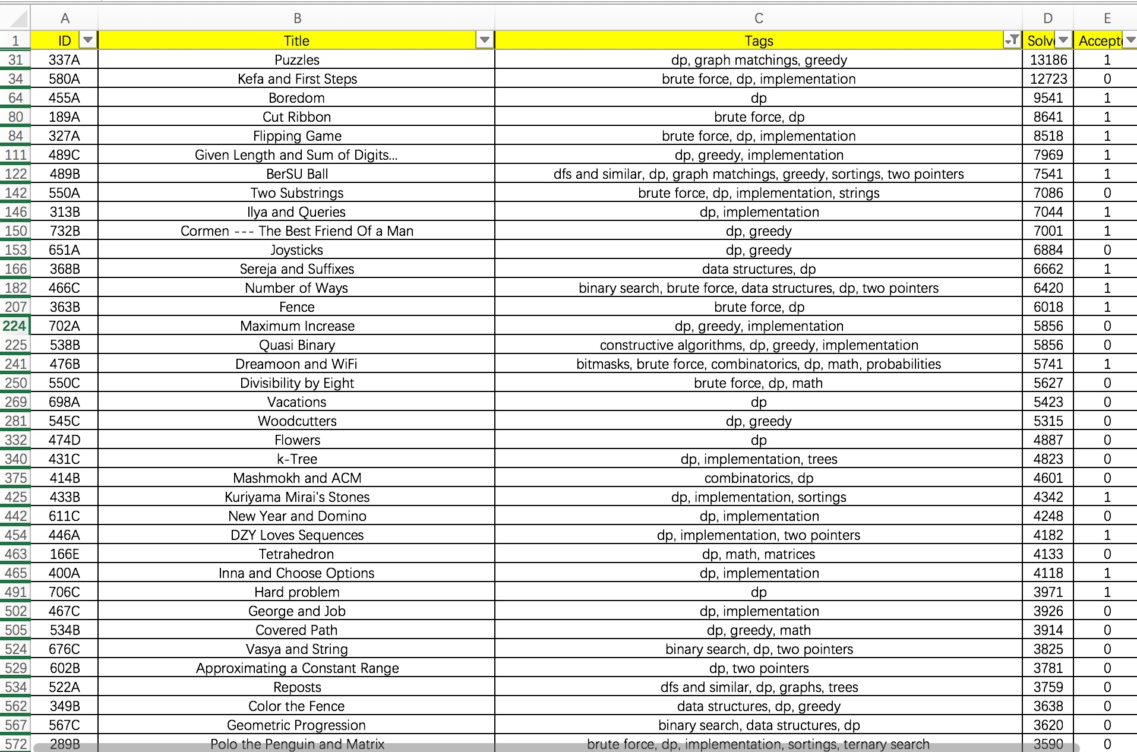
汇总了截止2017年1月3日Codeforces题目上的所有算法题
可以按照解决人数来进行刷题，
二来可以按照题目难度进行刷题，
三来还可以进行主题刷题

Slide 7
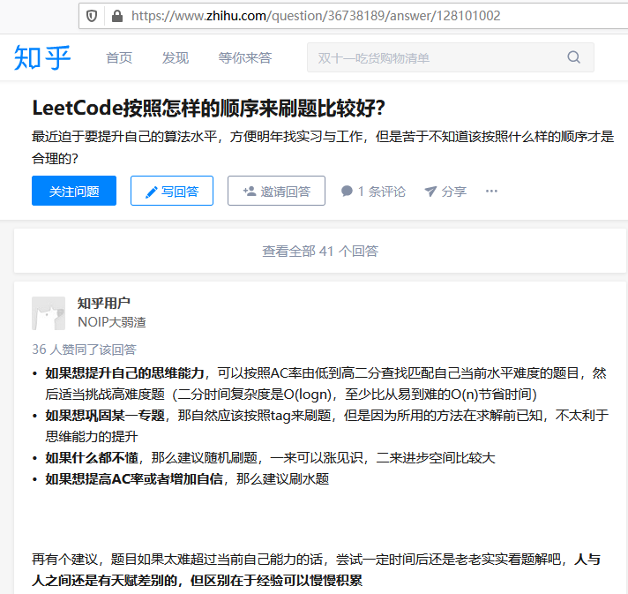
Notes:
https://www.zhihu.com/question/36738189/answer/128101002

Slide 8
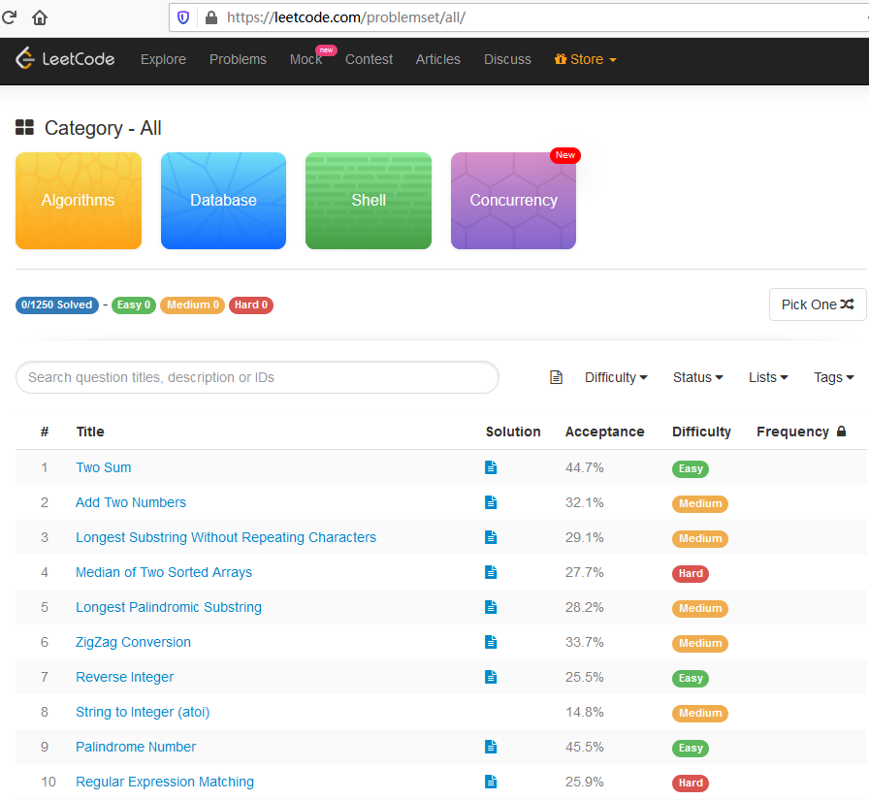
Notes:
https://leetcode.com/problemset/all/

Slide 9
大纲
先说结论
一张图、一张表、刷题观
如何用爬虫获取信息
必要的库
爬取Codeforces的所有算法题
标记已解决的算法题
输出爬取信息到csv文本
分析题目难度以及算法分类的关系
下载源代码以及分析结果

Slide 10
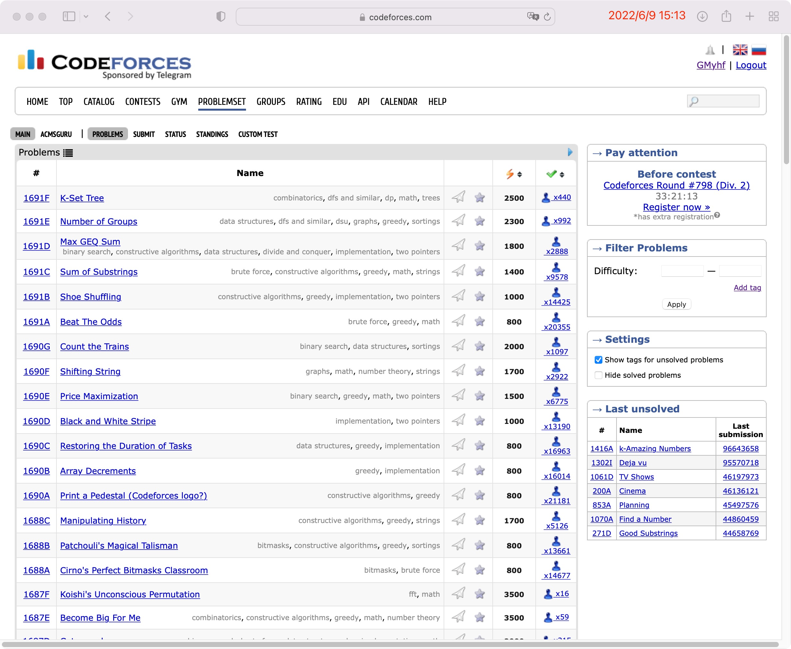

Slide 11
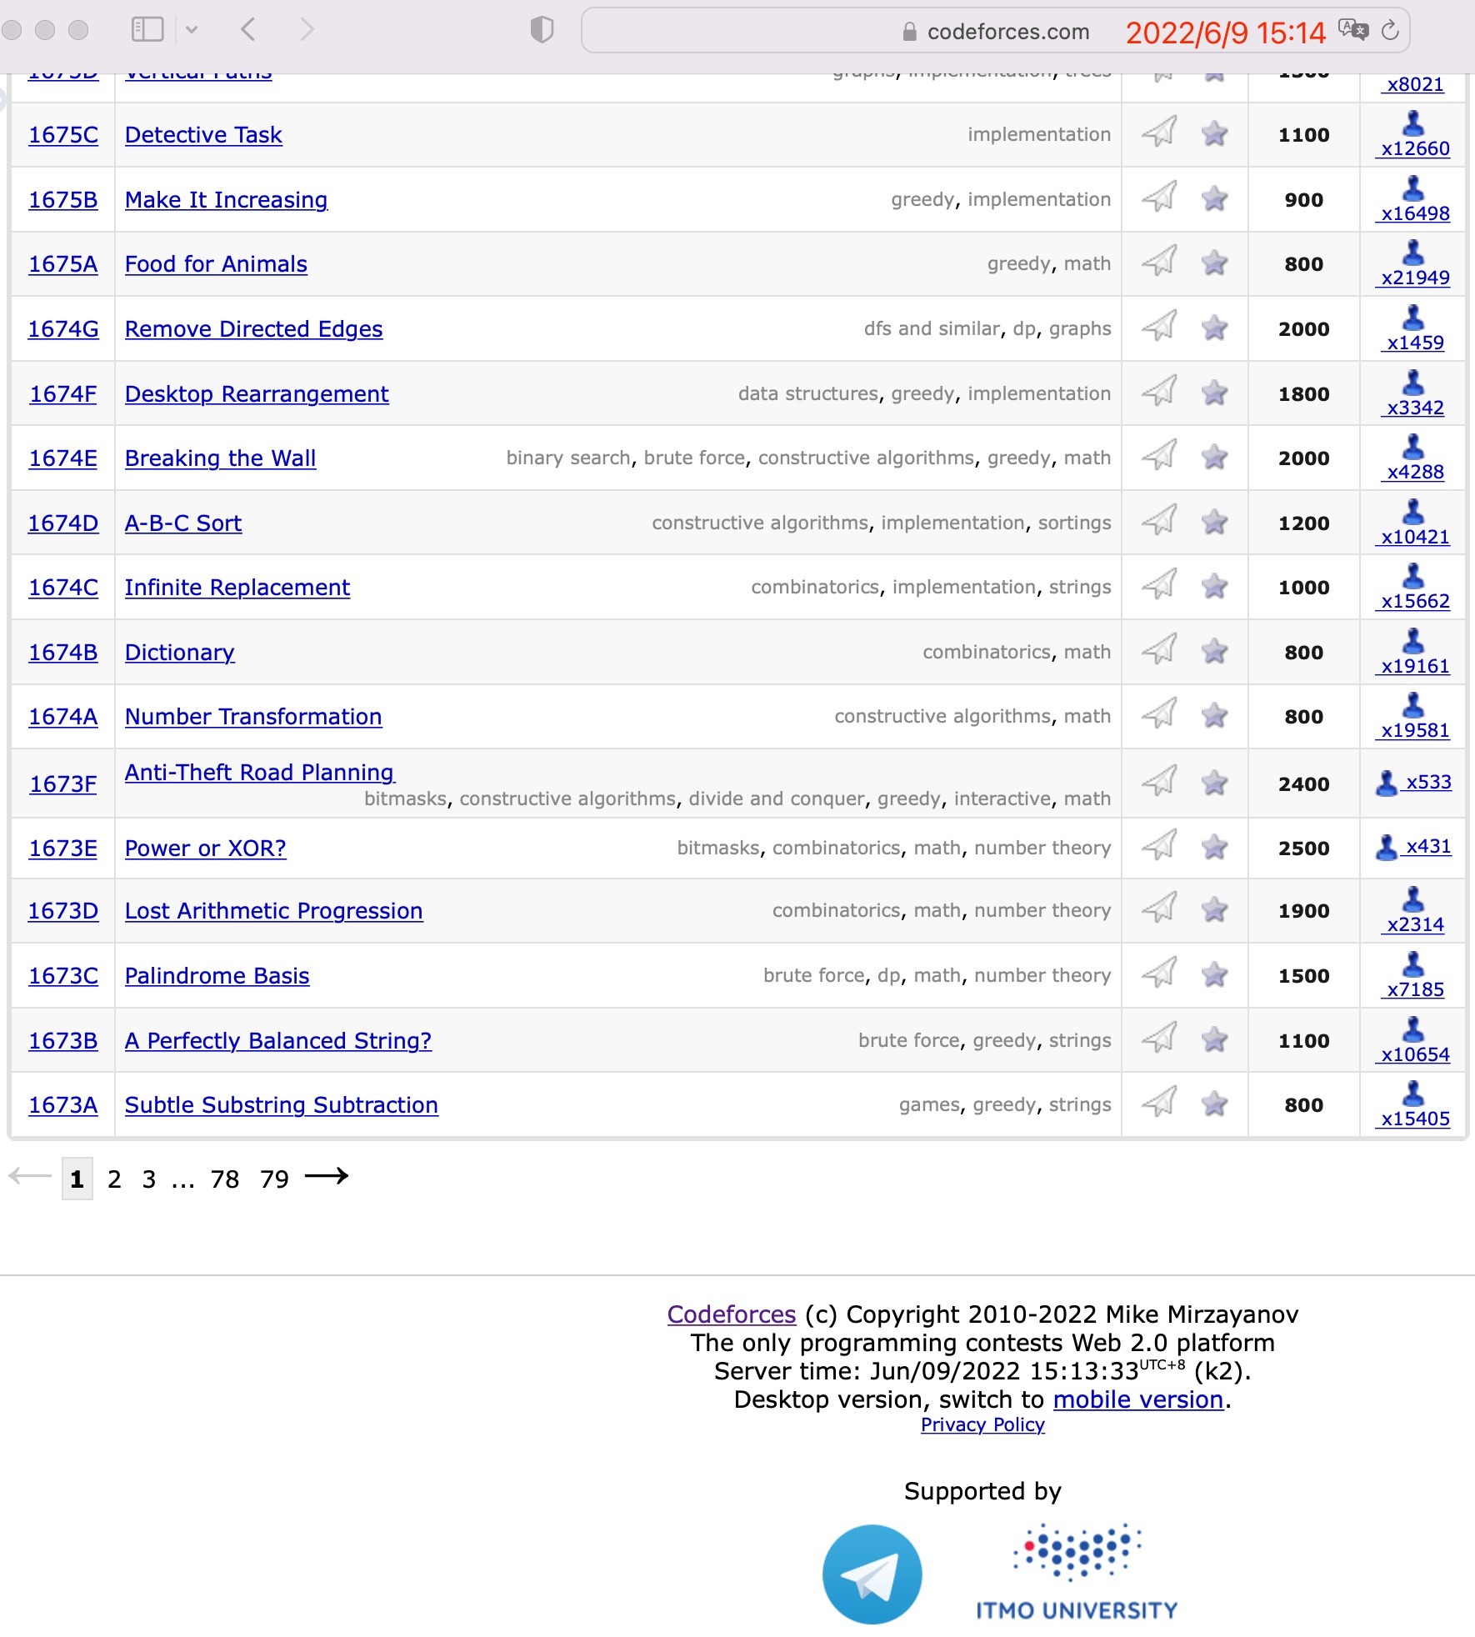

Slide 12
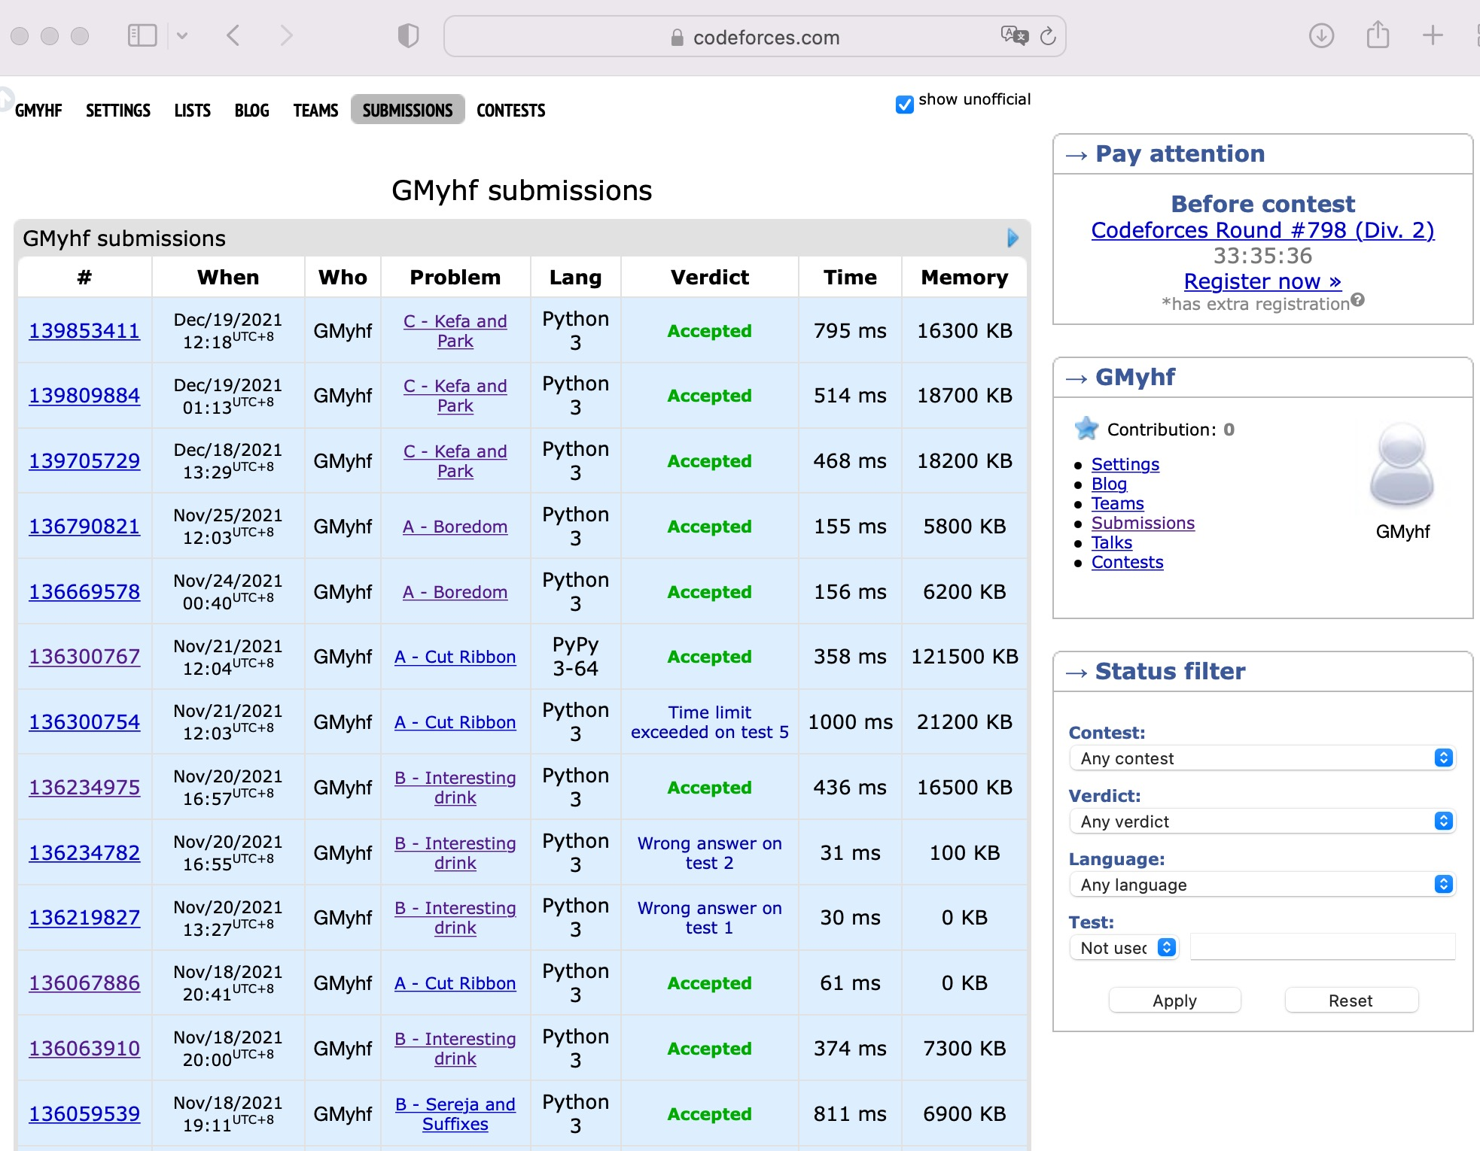
Notes:
http://codeforces.com/submissions/GMyhf/page/1

Slide 13
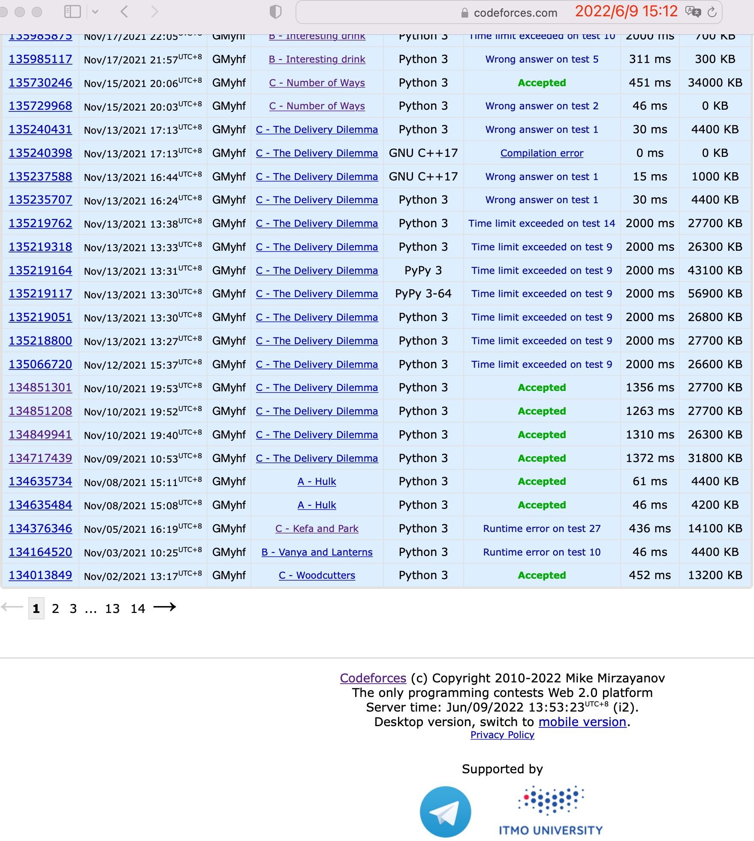
Notes:
http://codeforces.com/submissions/GMyhf/page/8

Slide 14
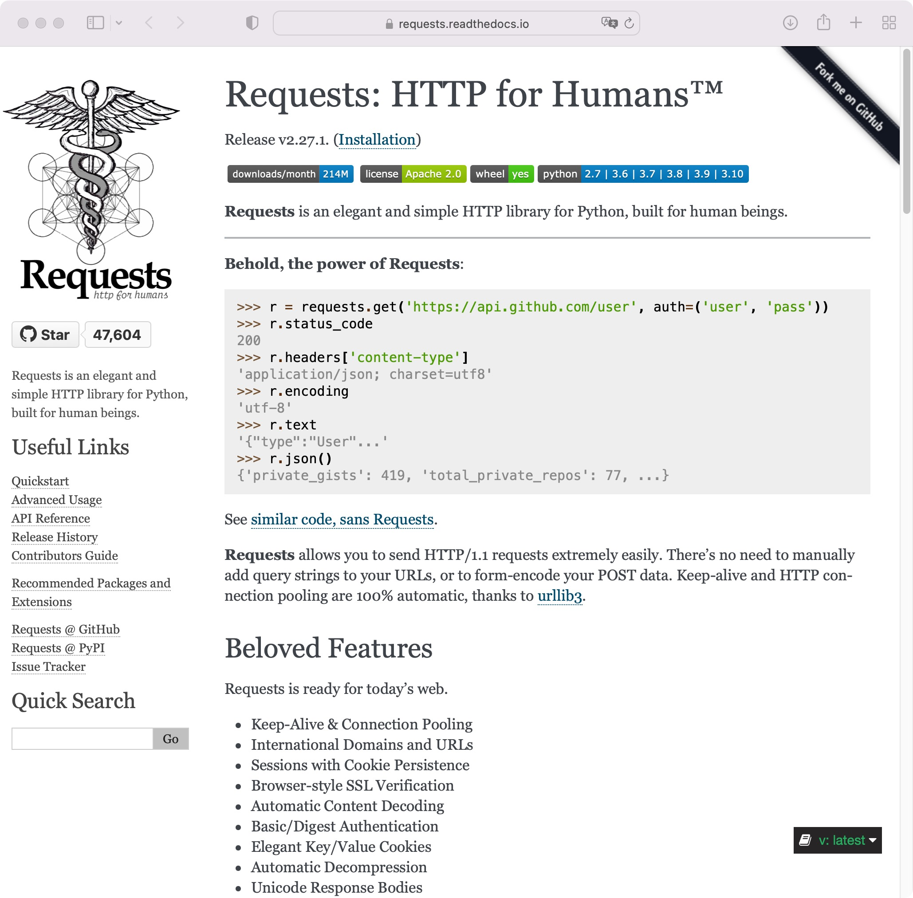
Notes:
在 get_page(url) 函数中用到了 requests 包。除了包含在Python标准库中的urllib模块外，requests 是使用 Python 进行HTTP请求的最流行的第三方Python软件包，https://requests.readthedocs.io/en/latest/

Slide 15
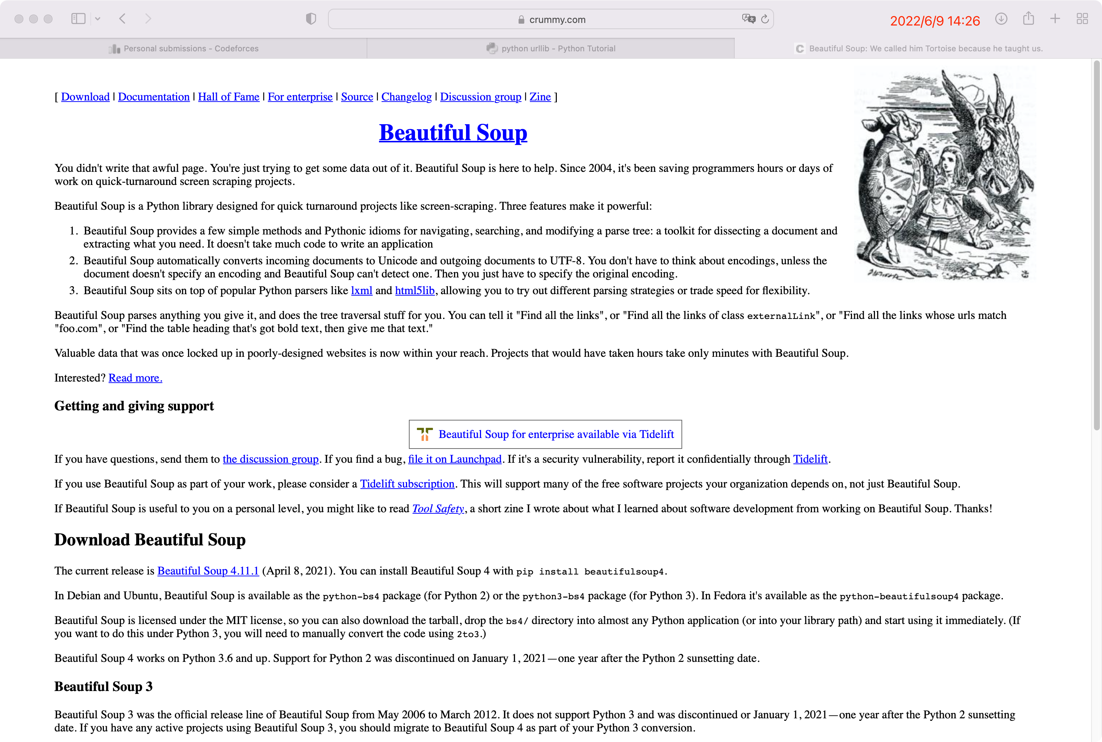
Notes:
https://www.crummy.com/software/BeautifulSoup/

Slide 16
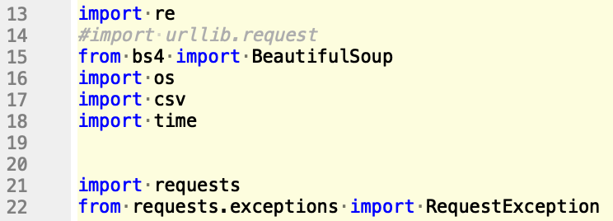
如何用爬虫获取信息
必要的库
Notes:
http://blog.greenwicher.com/2017/01/03/codeforces-problemset/

Slide 17
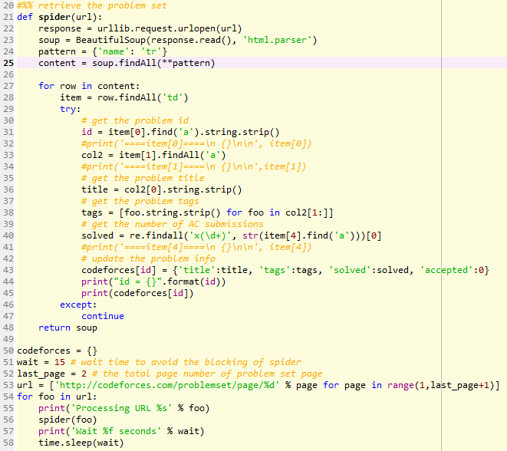
爬取Codeforces 的所有算法题

Slide 18
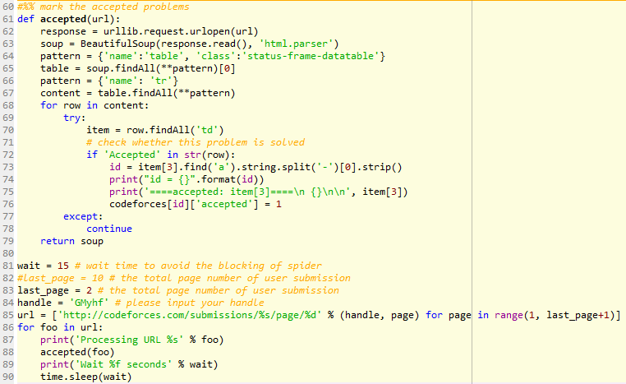
标记已解决的算法题

Slide 19
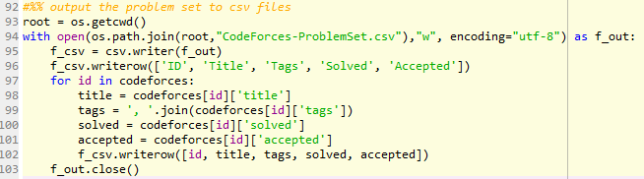
输出爬取信息到csv文本

Slide 20
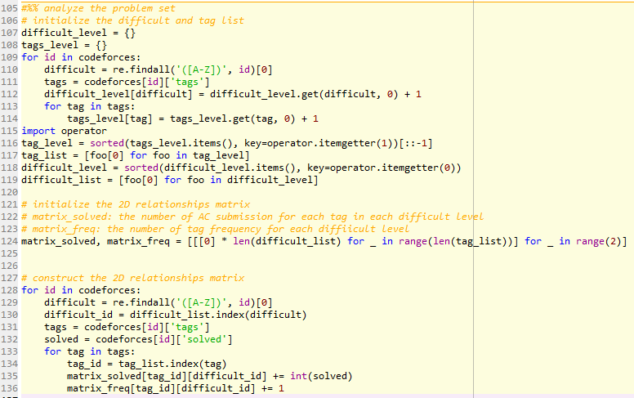
分析题目难度 以及算法分类的关系

Slide 21
网页抓取，提取和汇总的代码
https://github.com/GMyhf/Awsome-Project/tree/master/Codeforces%20Guide
Notes:
﻿#!/usr/bin/env python3
# -*- coding: utf-8 -*-
"""
updated on Jun. 9, 2022 by Hongfei Yan
maily add get_page(url) function
update: 2020-08-25 21:33:27
change: last_page = 64, fix bug--> tr td tag decode， add score and problem link columns
Created on Tue Jan 3 10:29:52 2017
@author: liuweizhi
"""
import re
#import urllib.request
from bs4 import BeautifulSoup
import os
import csv
import time
import requests
from requests.exceptions import RequestException
def get_page(url):
try:
headers = {
'user-agent': 'Mozilla/5.0 (Macintosh; Intel Mac OS X 10_15_7) AppleWebKit/537.36 (KHTML, like Gecko) Chrome/102.0.5005.61 Safari/537.36',
'accept-language': 'en-US,en;q=0.9',
'cache-control': 'max-age=0',
'accept': 'text/html,application/xhtml+xml,application/xml;q=0.9,image/avif,image/webp,image/apng,*/*;q=0.8,application/signed-exchange;v=b3;q=0.9',
'cookie': 'RCPC=f545fba99c66547075d0e5c03e8ad2e6; JSESSIONID=1EAFF194B52F87339FE470336F0852A3-n1; 39ce7=CFFwGWWZ; __utma=71512449.1890352982.1654744391.1654744391.1654744391.1; __utmc=71512449; __utmz=71512449.1654744391.1.1.utmcsr=(direct)|utmccn=(direct)|utmcmd=(none); __utmt=1; __utmb=71512449.1.10.1654744391'
}
response = requests.get(url=url, headers=headers)
response.encoding = "utf-8"
if response.status_code == 200:
return response.text
return None
except RequestException:
return None
def spider(url):
#resp = urllib.request.urlopen(url)
resp = get_page(url)
if resp == None:
print("fail to get ", url)
return
soup = BeautifulSoup(resp, features='html.parser')
ctx = soup.find_all("table", "problems")[0].find_all("tr")
for row in ctx:
item = row.find_all('td')
try:
# get the problem id
id = item[0].find('a').string.strip()
l = len(id)
p2 = id[l-1:l]
# 处理目前赛制题目命名的问题
if p2.isalpha():
p1 = id[0:l - 1]
p2 = id[l - 1:l]
else:
p1 = id[0:l - 2]
p2 = id[l - 2:l]
link = f'https://codeforces.com/problemset/problem/{p1}/{p2}'
col2 = item[1].find_all('a')
title = col2[0].string.strip()
tags = [foo.string.strip() for foo in col2[1:]]
score = item[3].find('span').string.strip()
solved = re.findall('x(\d+)', str(item[4].find('a')))[0]
codeforces[id] = {'title': title, 'tags': tags, 'score': score, 'solved': solved, 'accepted': 0,
"link": link}
print(codeforces[id])
except:
pass
codeforces = {}
wait = 5 # wait time to avoid the blocking of spider
last_page = 79 # the total page number of problem set page
url = ['https://codeforces.com/problemset/page/%d' % page for page in range(1,last_page+1)]
for foo in url:
print('Processing URL %s' % foo)
spider(foo)
print('Wait %f seconds' % wait)
time.sleep(wait)
#%% mark the accepted problems
def accepted(url):
#response = urllib.request.urlopen(url)
response = get_page(url)
if response == None:
print("fail to get ", url)
return
#soup = BeautifulSoup(response.read())
soup = BeautifulSoup(response)
pattern = {'name':'table', 'class':'status-frame-datatable'}
table = soup.findAll(**pattern)[0]
pattern = {'name': 'tr'}
content = table.findAll(**pattern)
for row in content:
try:
item = row.findAll('td')
# check whether this problem is solved
if 'Accepted' in str(row):
id = item[3].find('a').string.split('-')[0].strip()
codeforces[id]['accepted'] = 1
except:
continue
return soup
wait = 15 # wait time to avoid the blocking of spider
last_page = 14 # the total page number of user submission
handle = 'GMyhf' # ⭐⭐输入你的cf用户名 please input your handle
url = ['https://codeforces.com/submissions/%s/page/%d' % (handle, page) for page in range(1, last_page+1)]
for foo in url:
print('Processing URL %s' % foo)
accepted(foo)
print('Wait %f seconds' % wait)
time.sleep(wait)
#%% output the problem set to csv files
root = os.getcwd()
with open(os.path.join(root, "CodeForces-ProblemSet.csv"), "w", encoding="utf-8") as f_out:
f_csv = csv.writer(f_out)
f_csv.writerow(['ID', 'Title', 'Tags', 'Score', 'Solved', 'Accepted', 'Link'])
for id in codeforces:
title = codeforces[id]['title']
tags = ', '.join(codeforces[id]['tags'])
score = codeforces[id]['score']
solved = codeforces[id]['solved']
accepted = codeforces[id]['accepted']
link = codeforces[id]['link']
f_csv.writerow([id, title, tags, score, solved, accepted, link])
f_out.close()
#%% analyze the problem set
# initialize the difficult and tag list
difficult_level = {}
tags_level = {}
for id in codeforces:
# '(?i)[A-Z][0-9]',
difficult = re.findall('(?i)[A-Z]', id)[0]
tags = codeforces[id]['tags']
difficult_level[difficult] = difficult_level.get(difficult, 0) + 1
for tag in tags:
tags_level[tag] = tags_level.get(tag, 0) + 1
import operator
tag_level = sorted(tags_level.items(), key=operator.itemgetter(1))[::-1]
tag_list = [foo[0] for foo in tag_level]
difficult_level = sorted(difficult_level.items(), key=operator.itemgetter(0))
difficult_list = [foo[0] for foo in difficult_level]
# initialize the 2D relationships matrix
# matrix_solved: the number of AC submission for each tag in each difficult level
# matrix_freq: the number of tag frequency for each difficult level
matrix_solved, matrix_freq = [[[0] * len(difficult_list) for _ in range(len(tag_list))] for _ in range(2)]
# a-f tag freq
# a-f tag submission
# a-f score tag 1
# construct the 2D relationships matrix
for id in codeforces:
# '(?i)[A-Z][0-9]',
difficult = re.findall('(?i)[A-Z]', id)[0]
difficult_id = difficult_list.index(difficult)
tags = codeforces[id]['tags']
solved = codeforces[id]['solved']
for tag in tags:
tag_id = tag_list.index(tag)
matrix_solved[tag_id][difficult_id] += int(solved)
matrix_freq[tag_id][difficult_id] += 1
#%% visualization
root = os.getcwd()
def outputMatrix(name, data):
with open(os.path.join(root,name),"w", encoding="utf-8") as f_out:
f_csv = csv.writer(f_out)
f_csv.writerow(['Tags/Difficult '] + difficult_list)
for i in range(len(tag_list)):
tag = tag_list[i]
f_csv.writerow([tag]+data[i])
f_out.close()
return
outputMatrix('Matrix-Solved.csv', matrix_solved)
outputMatrix('Matrix-Freq.csv', matrix_freq)

Slide 22
Updated on Nov. 3, 2019

Slide 23
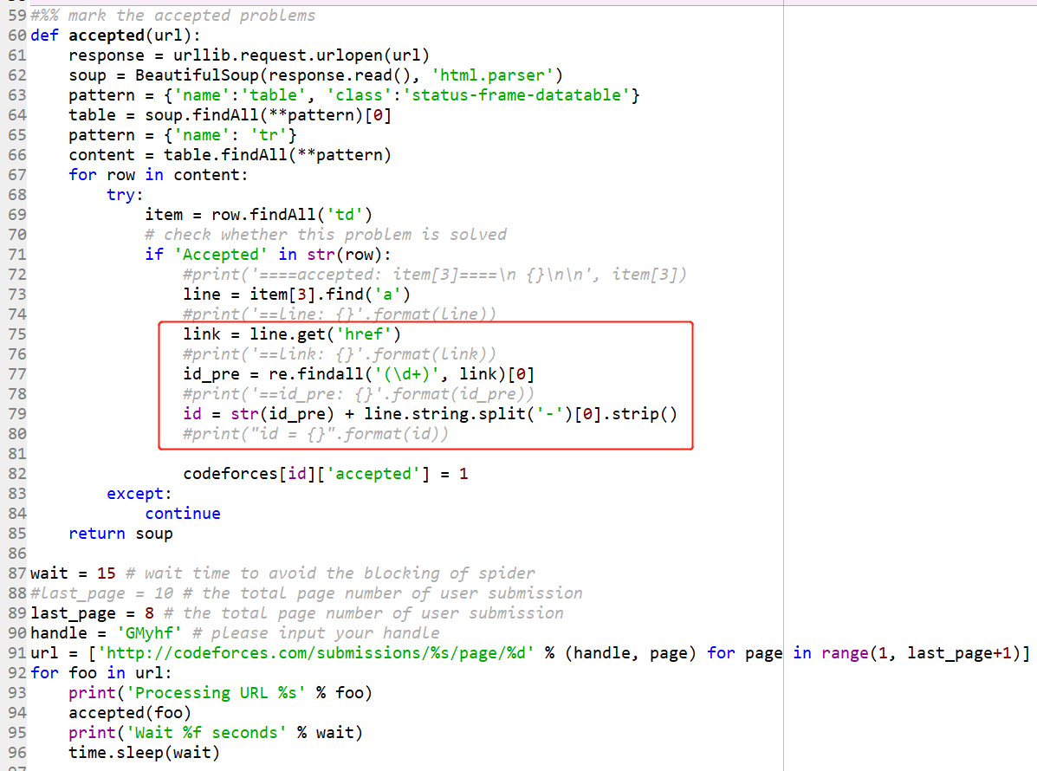
Notes:
def accepted(url):
response = urllib.request.urlopen(url)
soup = BeautifulSoup(response.read(), 'html.parser')
pattern = {'name':'table', 'class':'status-frame-datatable'}
table = soup.findAll(**pattern)[0]
pattern = {'name': 'tr'}
content = table.findAll(**pattern)
for row in content:
try:
item = row.findAll('td')
# check whether this problem is solved
if 'Accepted' in str(row):
#print('====accepted: item[3]====\n {}\n\n', item[3])
line = item[3].find('a')
#print('==line: {}'.format(line))
link = line.get('href')
#print('==link: {}'.format(link))
id_pre = re.findall('(\d+)', link)[0]
#print('==id_pre: {}'.format(id_pre))
id = str(id_pre) + line.string.split('-')[0].strip()
#print("id = {}".format(id))
codeforces[id]['accepted'] = 1
except:
continue
return soup

Slide 24
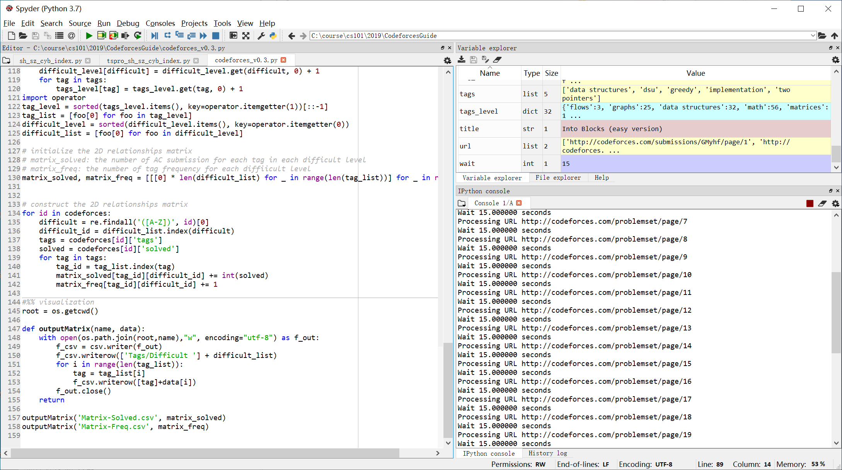

Slide 25
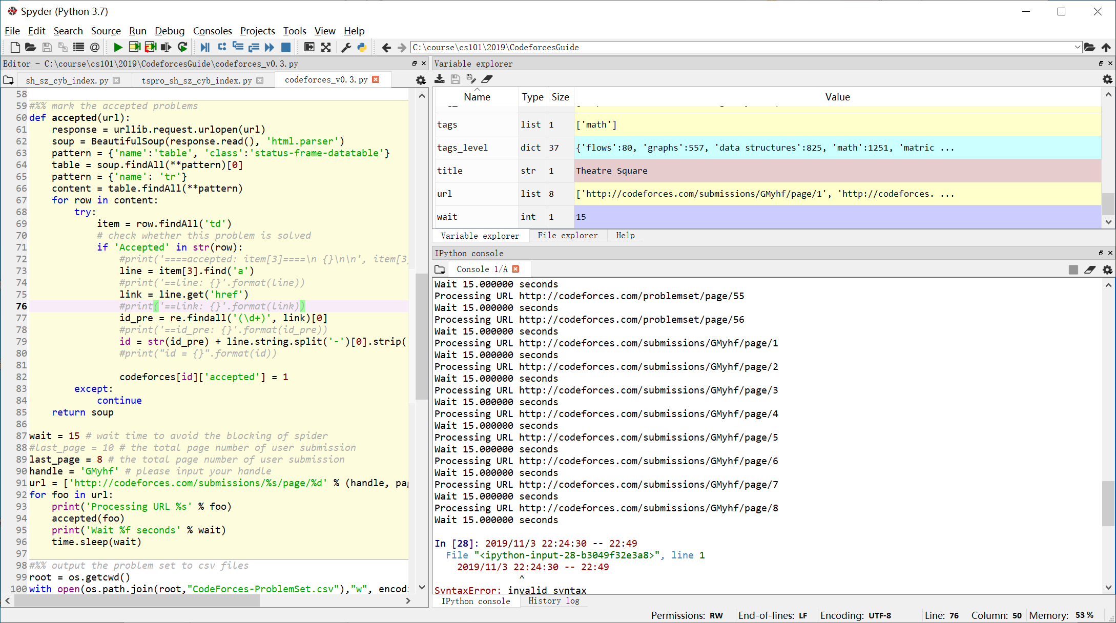
Notes:
2019/11/3 22:24:30 -- 22:49:00

Slide 26
排序

Slide 27
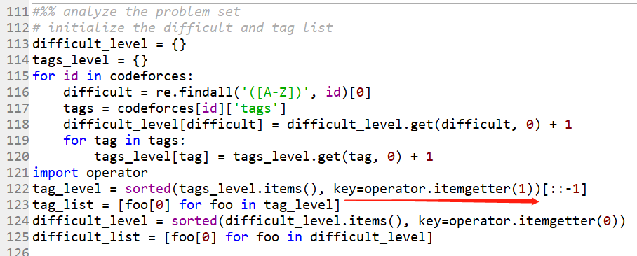

Slide 28
How does operator.itemgetter and sort() work in Python? https://stackoverflow.com/questions/18595686/how-does-operator-itemgetter-and-sort-work-in-python
https://docs.python.org/2/library/operator.html#operator.itemgetter

Slide 29
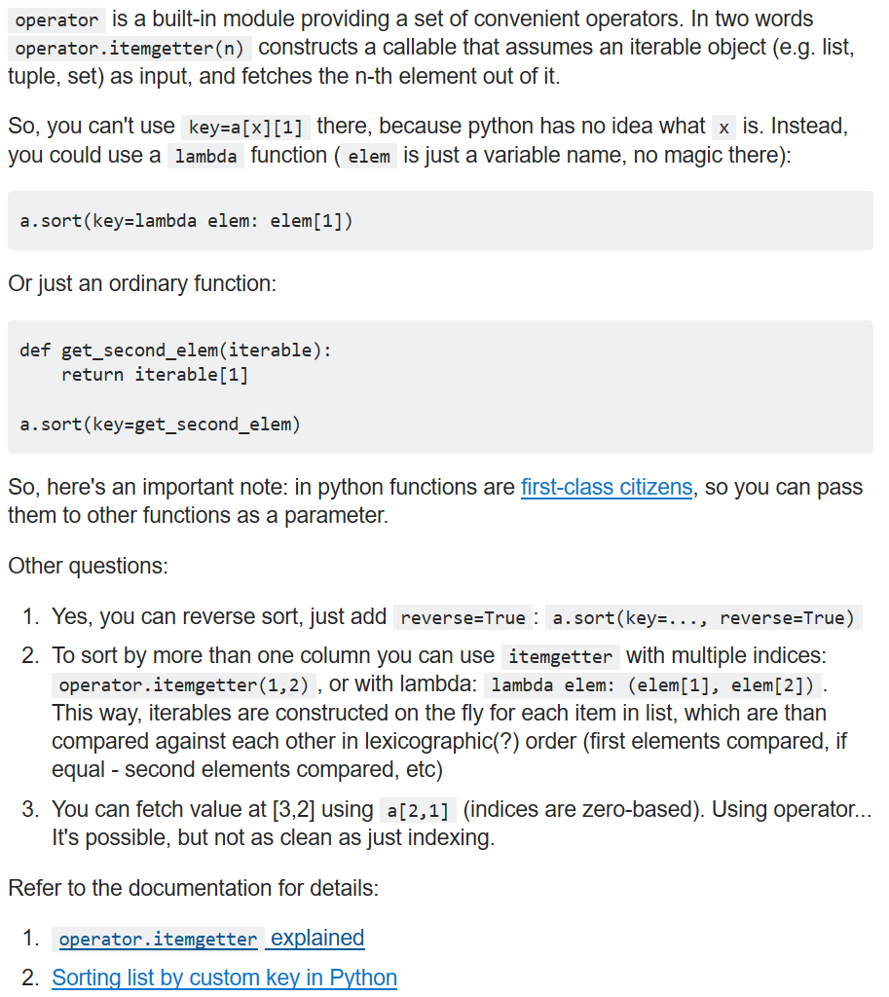

Slide 30
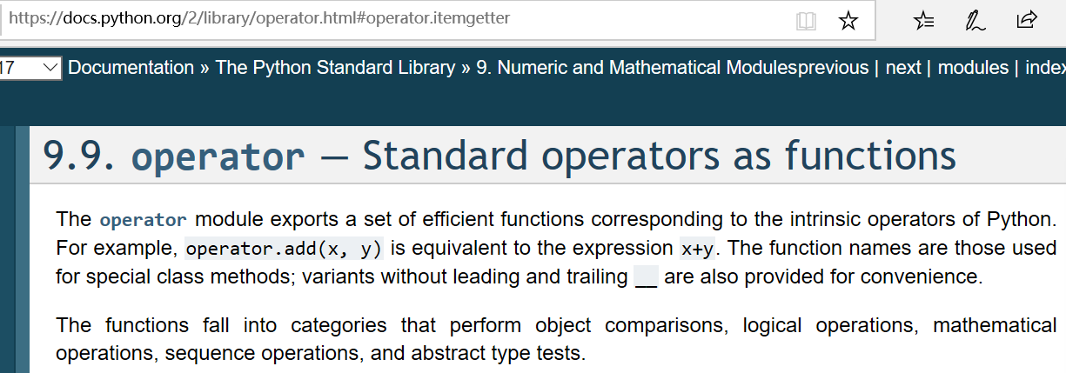
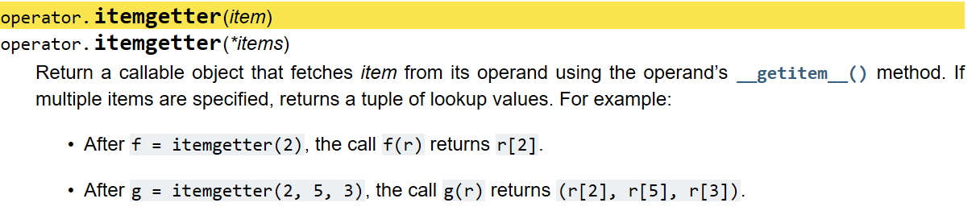
Notes:
https://docs.python.org/2/library/operator.html#operator.itemgetter

Slide 31
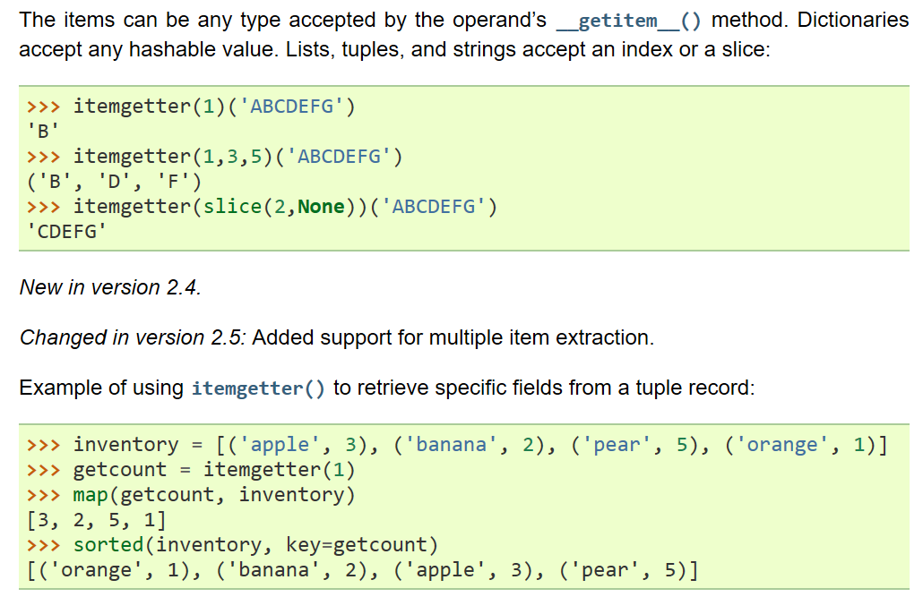

Slide 32
从网页中提取信息

Slide 33
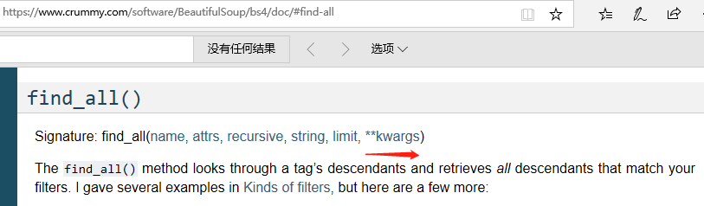
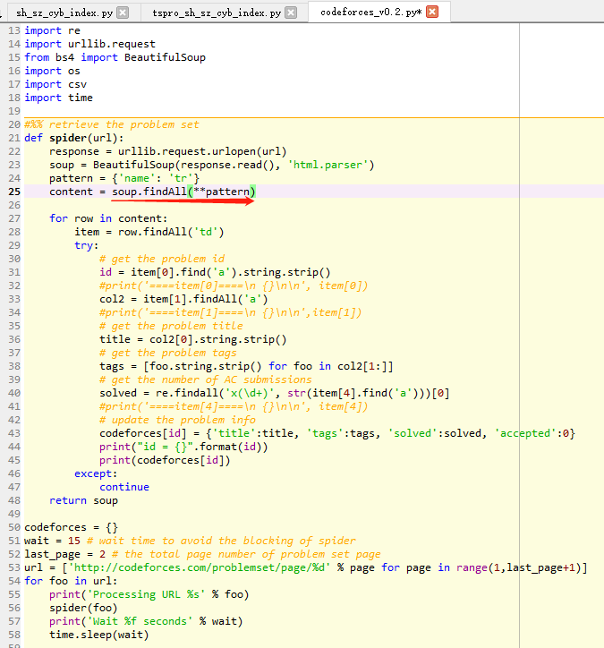
Notes:
https://www.crummy.com/software/BeautifulSoup/bs4/doc/#find-all

Slide 34
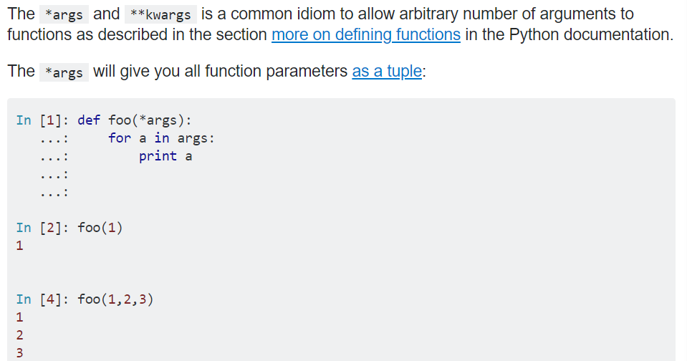
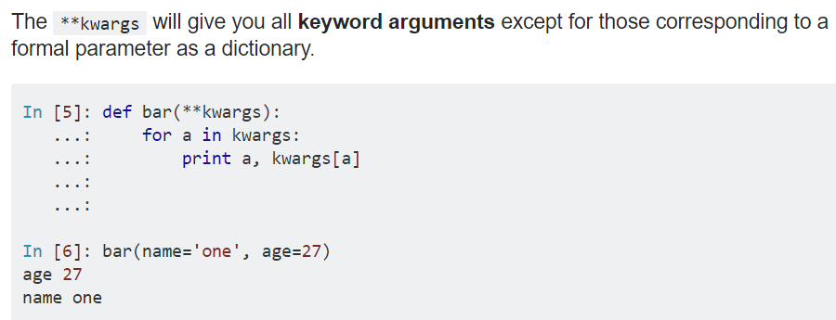
What does ** (double star/asterisk) and * (star/asterisk) do for parameters? https://stackoverflow.com/questions/36901/what-does-double-star-asterisk-and-star-asterisk-do-for-parameters

Slide 35
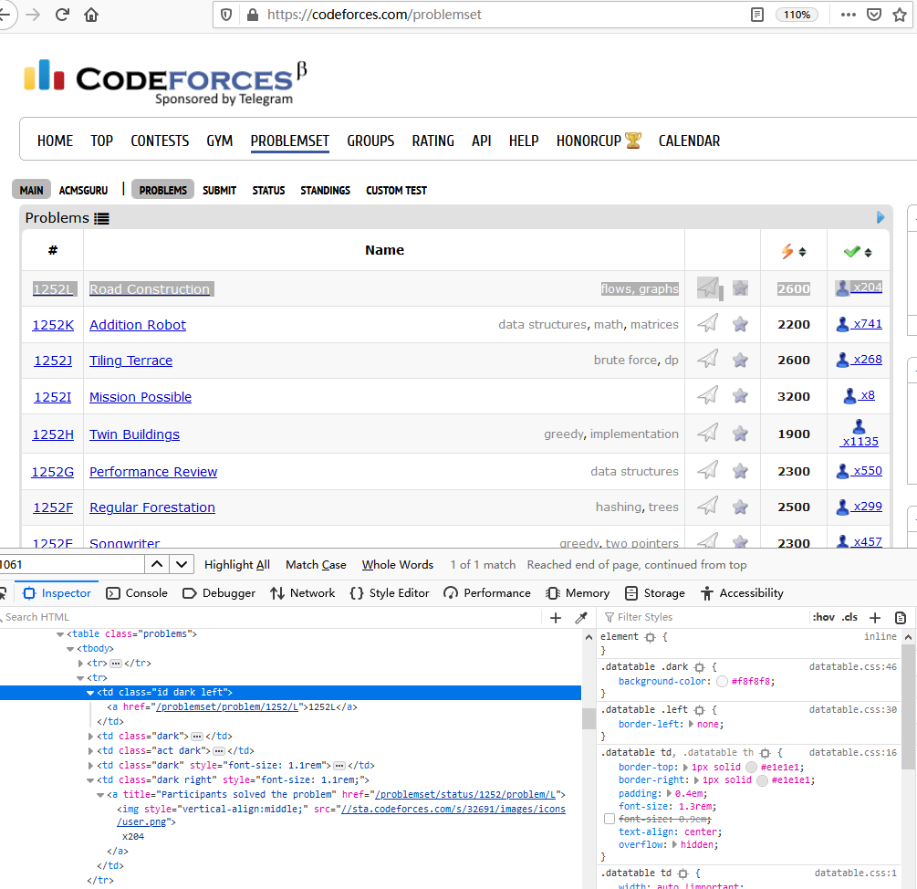

Slide 36
Codeforces_v0.3.py
Updated on Nov. 3, 2019
Notes:
#!/usr/bin/env python3
# -*- coding: utf-8 -*-
#http://blog.greenwicher.com/2017/01/03/codeforces-problemset/
"""
Created on Tue Jan 3 10:29:52 2017 by liuweizhi
updated on Nov. 3, 2019 by Hongfei Yan
"""
import re
import urllib.request
from bs4 import BeautifulSoup
import os
import csv
import time
#%% retrieve the problem set
def spider(url):
response = urllib.request.urlopen(url)
soup = BeautifulSoup(response.read(), 'html.parser')
pattern = {'name': 'tr'}
content = soup.findAll(**pattern)
#content = soup.findAll('tr')
for row in content:
item = row.findAll('td')
try:
# get the problem id
id = item[0].find('a').string.strip()
#print('====item[0]====\n {}\n\n', item[0])
col2 = item[1].findAll('a')
#print('====item[1]====\n {}\n\n',item[1])
# get the problem title
title = col2[0].string.strip()
# get the problem tags
tags = [foo.string.strip() for foo in col2[1:]]
# get the number of AC submissions
solved = re.findall('x(\d+)', str(item[4].find('a')))[0]
#print('====item[4]====\n {}\n\n', item[4])
# update the problem info
codeforces[id] = {'title':title, 'tags':tags, 'solved':solved, 'accepted':0}
#print("id = {}".format(id))
#print(codeforces[id])
except:
continue
return soup
codeforces = {}
wait = 15 # wait time to avoid the blocking of spider
last_page = 56 # the total page number of problem set page
url = ['http://codeforces.com/problemset/page/%d' % page for page in range(1,last_page+1)]
for foo in url:
print('Processing URL %s' % foo)
spider(foo)
print('Wait %f seconds' % wait)
time.sleep(wait)
#%% mark the accepted problems
def accepted(url):
response = urllib.request.urlopen(url)
soup = BeautifulSoup(response.read(), 'html.parser')
pattern = {'name':'table', 'class':'status-frame-datatable'}
table = soup.findAll(**pattern)[0]
pattern = {'name': 'tr'}
content = table.findAll(**pattern)
for row in content:
try:
item = row.findAll('td')
# check whether this problem is solved
if 'Accepted' in str(row):
#print('====accepted: item[3]====\n {}\n\n', item[3])
line = item[3].find('a')
#print('==line: {}'.format(line))
link = line.get('href')
#print('==link: {}'.format(link))
id_pre = re.findall('(\d+)', link)[0]
#print('==id_pre: {}'.format(id_pre))
id = str(id_pre) + line.string.split('-')[0].strip()
#print("id = {}".format(id))
codeforces[id]['accepted'] = 1
except:
continue
return soup
wait = 15 # wait time to avoid the blocking of spider
#last_page = 10 # the total page number of user submission
last_page = 8 # the total page number of user submission
handle = 'GMyhf' # please input your handle
url = ['http://codeforces.com/submissions/%s/page/%d' % (handle, page) for page in range(1, last_page+1)]
for foo in url:
print('Processing URL %s' % foo)
accepted(foo)
print('Wait %f seconds' % wait)
time.sleep(wait)
#%% output the problem set to csv files
root = os.getcwd()
with open(os.path.join(root,"CodeForces-ProblemSet.csv"),"w", encoding="utf-8") as f_out:
f_csv = csv.writer(f_out)
f_csv.writerow(['ID', 'Title', 'Tags', 'Solved', 'Accepted'])
for id in codeforces:
title = codeforces[id]['title']
tags = ', '.join(codeforces[id]['tags'])
solved = codeforces[id]['solved']
accepted = codeforces[id]['accepted']
f_csv.writerow([id, title, tags, solved, accepted])
f_out.close()
#%% analyze the problem set
# initialize the difficult and tag list
difficult_level = {}
tags_level = {}
for id in codeforces:
difficult = re.findall('([A-Z])', id)[0]
tags = codeforces[id]['tags']
difficult_level[difficult] = difficult_level.get(difficult, 0) + 1
for tag in tags:
tags_level[tag] = tags_level.get(tag, 0) + 1
import operator
tag_level = sorted(tags_level.items(), key=operator.itemgetter(1))[::-1]
tag_list = [foo[0] for foo in tag_level]
difficult_level = sorted(difficult_level.items(), key=operator.itemgetter(0))
difficult_list = [foo[0] for foo in difficult_level]
# initialize the 2D relationships matrix
# matrix_solved: the number of AC submission for each tag in each difficult level
# matrix_freq: the number of tag frequency for each diffiicult level
matrix_solved, matrix_freq = [[[0] * len(difficult_list) for _ in range(len(tag_list))] for _ in range(2)]
# construct the 2D relationships matrix
for id in codeforces:
difficult = re.findall('([A-Z])', id)[0]
difficult_id = difficult_list.index(difficult)
tags = codeforces[id]['tags']
solved = codeforces[id]['solved']
for tag in tags:
tag_id = tag_list.index(tag)
matrix_solved[tag_id][difficult_id] += int(solved)
matrix_freq[tag_id][difficult_id] += 1
#%% visualization
root = os.getcwd()
def outputMatrix(name, data):
with open(os.path.join(root,name),"w", encoding="utf-8") as f_out:
f_csv = csv.writer(f_out)
f_csv.writerow(['Tags/Difficult '] + difficult_list)
for i in range(len(tag_list)):
tag = tag_list[i]
f_csv.writerow([tag]+data[i])
f_out.close()
return
outputMatrix('Matrix-Solved.csv', matrix_solved)
outputMatrix('Matrix-Freq.csv', matrix_freq)

